Slide 1

Data Analysis
Predicting the Genre of a Song

Slide 2
Motivation
Genres in any industry are subjective. Definitions can change over time, and the more specific you try to get, the more people will angrily tell you you’re wrong. But the basic genres will have a few principle aspects that make it easier to identify them.
For the most part, genres are defined by the experiences
The ideal process would be to use all the representative features of an entertainment medium, figure out how to interpret the values for these features from the source material, grab a bunch of data, throw it in a classification algorithm, and boom, genres!

Slide 3
Tools
Sk-learn was great for building and testing different models
Pandas/NumPy was nice for storing the data. I also used Flask to help make the app.
SeaBorn was great to make visualizations with the paired tool matplotlib
Other imports were used for small necessities.

Slide 4
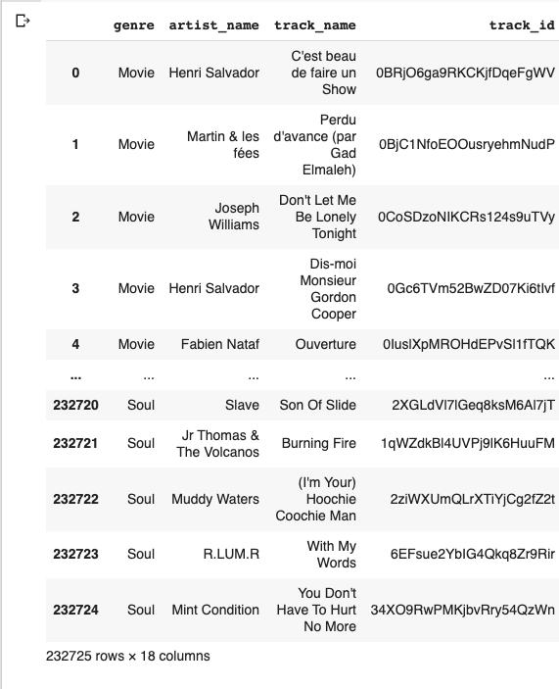
My Data: “Spotify Tracks DB”
Created by Zaheen Hamidani on Kaggle
Total of 232,725 tracks, with each Track containing 18 features including our target class ‘genre’
There are 26 different genres in the full dataset

Slide 5
Assumptions
In this lab we made a few very large assumptions that if were not made, would have completely changed the results of the project.
First we assumed that the data had not been balanced to resemble to real world distribution of the frequencies of genres. Because of this assumption we were forced to rebalance the data and in turn change the overall applicability of our project.
Second we assumed that this data had been randomly selected without bias. Obviously this is not something we are capable of verifying, but with most test labs, it is a common assumption.

Slide 6
Features
genre: a category of artistic composition
artist_name: the name of the artist
track_name: the name of the song
track_id: the Spotify Id of the song (every song has a unique id)
popularity: the spotify's rating of popularity (range: [1,100])
acousticness: A confidence measure from 0.0 to 1.0 of whether the track is acoustic.
danceability: Danceability describes how suitable a track is for dancing based on a combination of musical elements including tempo, rhythm stability, beat strength, and overall regularity.
duration_ms: the length of the song measure in milliseconds
Energy: Energy is a measure from 0.0 to 1.0 and represents a perceptual measure of intensity and activity.
Instrumentalness: Predicts whether a track contains no vocals.
key: the key the song is played in
liveness: Detects the presence of an audience in the recording.
Loudness: The overall loudness of a track in decibels (dB).
Mode: whether the song is played in a minor or major chord
speechiness: Speechiness detects the presence of spoken words in a track.
tempo: the pace at which the song is played at
time signature: the signature the pace of the song is played at
valence: A measure from 0.0 to 1.0 describing the musical positiveness conveyed by a track.

Slide 7
Data Analysis
Data Exploration

Slide 8
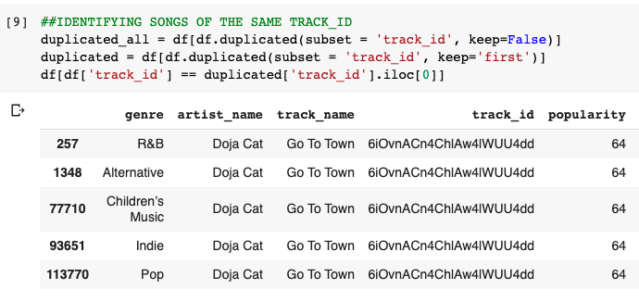
Duplicates and Missing info
On a positive note, our data frame contained no NaNs, which is great for knowing that we won't be required to remove to replace feature values.
However, even though there were no missing pieces of information, there were songs that labelled were into multiple genres. Take a look at this data
Analysis of full dataframe:
Unique Duplicates: 55951
Total Duplicates: 91075
Total Data: 232725
Duplicates %: 39.13

Slide 9
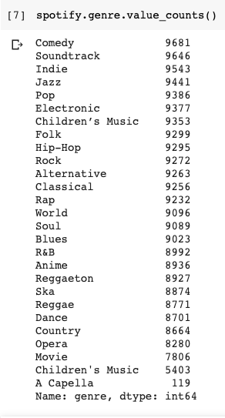
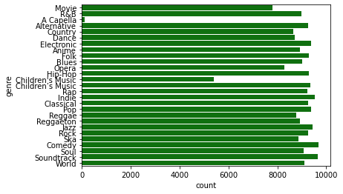
Unbalanced Data
Notice that the instances of each genre are not balanced. We need to change this later
Imbalanced classes put “accuracy” out of business.
Notice:
There is 2 copies of the same genre

Slide 10
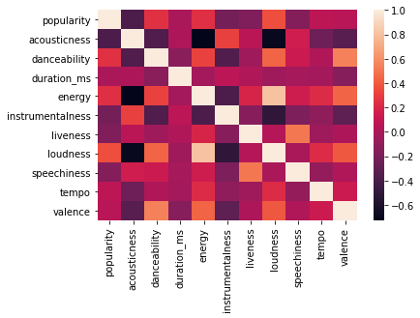
More Visuals...

Slide 11
Data Analysis
Data Preparation

Slide 12
Duplicate Class Labels
Notice that some target variable values in our data are have the same name but are not labeled the same (Children's Music).
Solution: The apostrophe in the two words are different! Now we will have to use the replace() function to rename all the children's music values
#REPLACES 2 DIFFERENT GENRE TITLES WITH 1 COMMON LABEL
df.genre=df.genre.replace({"Children's Music": "Children's Music"})
df.genre=df.genre.replace({"Children’s Music": "Children's Music"})
Notes:
**Notice that the class label 'A Capella' and Children's Muisc are not well represented in our data, and therefore we will not be able to accuractly predict the a song that can be considered to be A Capella or Children's Muisc.**
**We will need to remove all instances of songs that are Children's Muisc**
**We will need to remove all instances of songs that are A Capella**

Slide 13
Imbalance of “A Capella” instances
Notice that the class label 'A Capella' are not well represented in our data, and therefore we will not be able to accurately predict the a song that can be considered to be A Capella.
We will need to remove all instances of songs that are A Capella
#REMOVES A CAPELLEA GENRE FROM DF
df = df[df['genre'] != 'A Capella']

Slide 14
Class Labels with bad symbols
Notice that some target variable values in our data are have symbols that can be harmful to the model building process later in this lab (R&B, Hip-Hop)
Lets rename all of the values in the genre series that we don't want...
#REPLACES 2 UNPARSABLE GENRE TITLES WITH PARSABLE LABEL
df.genre=df.genre.replace({'R&B': 'RnB'})
df.genre=df.genre.replace({'Hip-Hop': 'HipHop'})

Slide 15
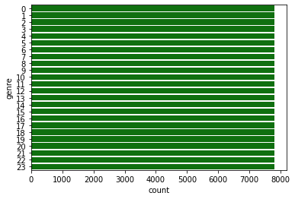
Rebalancing Data
Notice that our data is not representative of the frequencies of real world genres. We will need to rebalance the dataset by removing any instances of genres that exceed the genre whose class label is least expressed in the data. This will allow us to create a uniform dataset to have our models learn on

Slide 16
Data features unique to a song
Notice that some non target feature values in our data are unique to a specific song
Because of this, our machine learning models will not be able to accurately and precisely predict our target outcome genre.
In order to fix this we will need to remove all non-target variables, whos feature values have unique information to a singular song will need to be removed.
##REMOVES IDENTIFIER FEATURES
columns_to_drop=['artist_name','track_name','track_id',]
df=df.drop(columns=columns_to_drop)

Slide 17
Labeling categorical data
Notice that our feature values are not all in the same format. We will need to binarize categorical and discrete data found in our feature values
Since our data is not all in the same format, our classification methods will become useless in interpreting the significance of the difference between; for example, the key C# and F#.
This is why we must label the categorical variables (genre, mode) and one hot-encode discrete variables (key and time-signature).

Slide 18
Scaling Data
Since each column is not all expressed in the same means of units, we will need to normalize, or scale our entire dataframe.
We have many options, however there seems to be one that would be best suited for this situation. The MinMaxScaler.
#HELPER FUNCTION TO SCALE DATAFRAME
def scaleColumns(df, cols_to_scale):
min_max_scaler = MinMaxScaler()
for col in cols_to_scale:
df[col] = pd.DataFrame(min_max_scaler.fit_transform(pd.DataFrame(df[col])),columns=[col])
return df

Slide 19
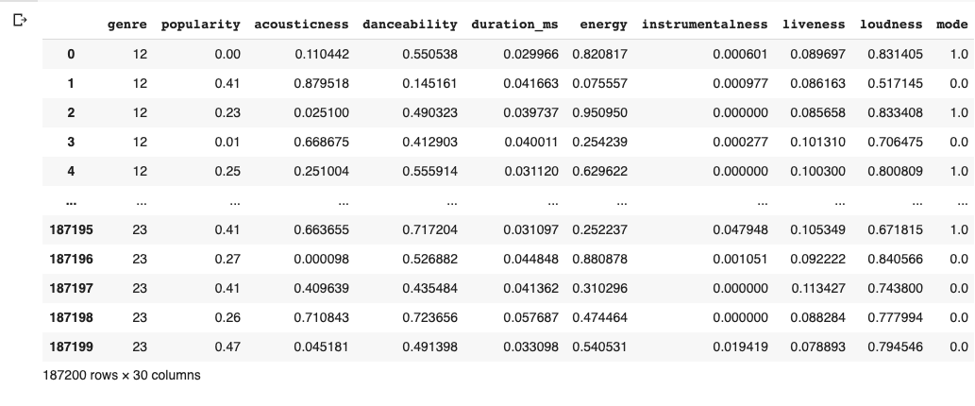
Resulting Data (Notice: col # and sample count)

Slide 20
Data Analysis
Model Preparation

Slide 21
Train Validate Test Sets
Typically, this is done after the models have been created and are ready to be fit, however seeing that we will be testing multiple models, we will need our data to be separated into 3 partitions; Train, Validation and test sets
Sets:
Train (60% of our data)
Validation (20% of our data)
Test (20% of our data)

Slide 22
Model Selection
Aftering taking a look at our goal of the project one more time, it is clear that we will be using as many classification algorithms as we see fit. We will analyze each of them and then select the best model.
Using the most common classification models:
'KNeighborsClassifier',
'DecisionTreeClassifier',
'RandomForestClassifier',
'LogisticRegression'

Slide 23
Data Analysis
Model Building

Slide 24
Building our Models
Note: Our goal is to find the best model to predict the genre of a single single song using various machine learning classification algorithms.
Lets also use a grid search to tune our hyperparameters.
This will not be time efficient, this will take a minute, but it will find the best result

Slide 25
Final Models
#KNN Classifier with GRIDSEARCH hyperparameters
hyperparameters={'ALL POSSIBLE HYPERPARAMETERS’}
knn=KNeighborsClassifier()
knn=GridSearchCV(knn, hyperparameters)
knn.fit(xtrain,ytrain.values.reshape(-1,1))
#DT Classifier with GRIDSEARCH hyperparameters
hyperparameters={'ALL POSSIBLE HYPERPARAMETERS’}
dt=DecisionTreeClassifier()
dt=GridSearchCV(dt, hyperparameters)
dt.fit(xtrain,ytrain.values.reshape(-1,1))
#RF Classifier with GRIDSEARCH hyperparamters
hyperparameters={'ALL POSSIBLE HYPERPARAMETERS’}
rf=RandomForestClassifier()
rf=GridSearchCV(rf, hyperparameters)
rf.fit(xtrain,ytrain.values.reshape(-1,1))
#LOG REG Classifier with GRIDSEARCH hyperparamters
hyperparameters={'ALL POSSIBLE HYPERPARAMETERS’}
lgr=LogisticRegression(multi_class='multinomial')
lgr=GridSearchCV(lgr, hyperparameters)
lgr.fit(xtrain,ytrain.values.reshape(-1,1))

Slide 26
Solution to the issue in our Data
Instead of predicting 1 genre, for a song that fits in many different genres. We should predict the top 'n' genres, where n is a # of predictions a model can make.
This way the model will be able to make a variety of guesses without being confused about how a single song can have multiple labels.
I created the n variable in case we want to change the n value to increase our models accuracy.
I also created a helper function to change our "single label ypred-ictions" to a array of "multi-labeled ypred-ictions"

Slide 27
Models on Validation set
For this instance we will bump up the # of estimates the model will be allowed to present to 5. This way if the accuracy of a model is below a 25%, we can conclude that that model is not well suited for this data and we can remove it
Results from predictions:
K Nearest Neighbors Classifier Accuracy Percentage: 0.71
Decision Tree Classifier Accuracy Percentage: 0.7
Random Forest Classifier Accuracy Percentage: 0.86
Logistic Regression Classifier Accuracy Percentage: 0.81

Slide 28
Data Analysis
Results

Slide 29
Models on Test set
Accuracy Percentages for each model:
K Nearest Neighbors = 0.79
Decision Tree Classifier = 0.68
Random Forest Classifier: = 0.84
Logistic Regression Classifier= 0.78
Hardest genres for RF model to classify:
Movie (F1-score = .7)
Country (F1-score = .71)
Anime (F1-score = .76)
Children’s Music (F1-score = .76)
Soul

Slide 30
Is this really our best model
Note: Our goal is to find the best model to predict the genre of a single single song using various machine learning classification algorithms.
All of these models serve our purpose in predicting the genre of a song, some even predict better than others.
**We can use all of these models to create a SUPERMODEL**
The bagging method takes all of these models and uses them to create a voting classifier which can take the output predictions of each and select the predictions that are the most common.
This is also known as using a Voting Classifier in SKLearn...

Slide 31
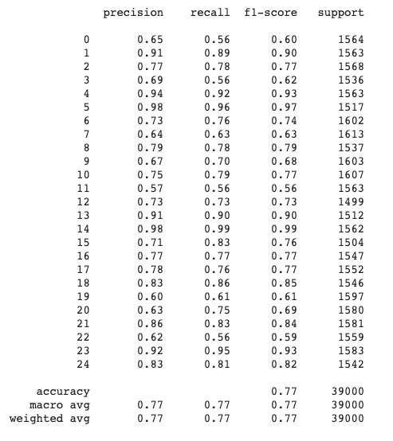
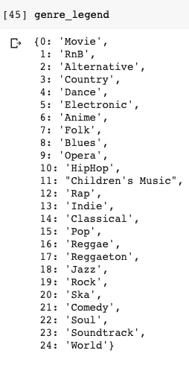
VotingClassifier Results
After giving our Voting Classifier all of our previously defined models, we can optimize its hyper parameters using grid search as well.
Observing our results from the classification report in SkLearn, we can see that the accuracy of the Voting-Classifier is actually less than the Random Forest Classifier, Decision Tree, and Logistic Regression Models.

Slide 32
CONCLUSION (and limitations)
In this project we discovered that we can predict the genre of a single song using the Random Forest Classifier with an accuracy of 84%. However, our models were only capable of this when presented with the opportunity to estimate more than one genre of a song. This addresses our largest issue in the dataset. Our contained a total of 40% duplicate tracks. Most of which had multiple genre labels as we observed earlier in the exploration of this lab.
In this lab we made a few very large assumptions that if were not made, would have completely changed the results of the project. Since our data wasn't balanced, and we did rebalance the information we must conclude that this model is not applicable to the real world. We do not know the frequencies of the amounts of songs that fit in each genre in the real world. This was something that was unforeseen as the project begun, and it is something I would change if I had more time to work on the project. Additionally, I would've preferred it use Bayesian optimization to limit the total run time of the project. Using Grid Search to optimize the parameters of 5 total models did not allow this project to be quickly analyzed, but it Bayesian optimization was utilized, I believe the project run time would have reduced significantly.

